Slide 1
Machine Learning
K-Nearest Neighbors Notes

Slide 2
Instance-based Learning (Lazy Learning)
Hypothesis: Similar instances (samples) have probably the same target.
Instance-based Learners: Predict based on identical/similar instances.
For each new (unseen) sample, the classifier/regressor searches similar instances and utilizes voting/averaging to predict the targets.
Advantages:
  No training is required (Lazy).
  Easy to adapt/fit on new training samples (The new instance is added to the training set; no training is required).
  Easy to implement.
  Less sensitive to outliers.
Disadvantages:
  Performance depends on the training set quality (e.g., the amount of noise).
  Finding similar samples can be slow/time-consuming in large datasets.
  Sensitive to irrelevant features and different feature scales.

Slide 3
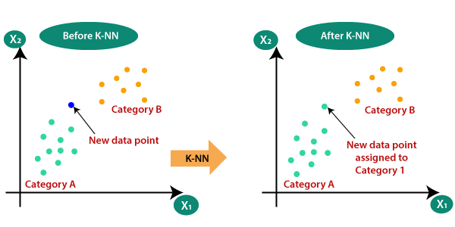
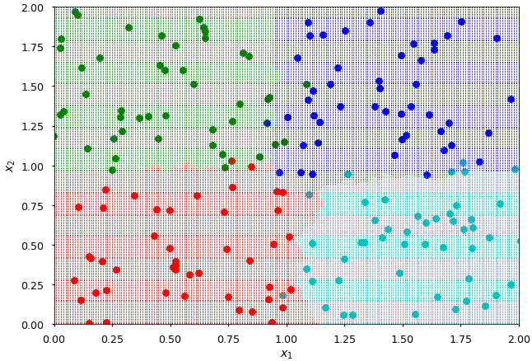
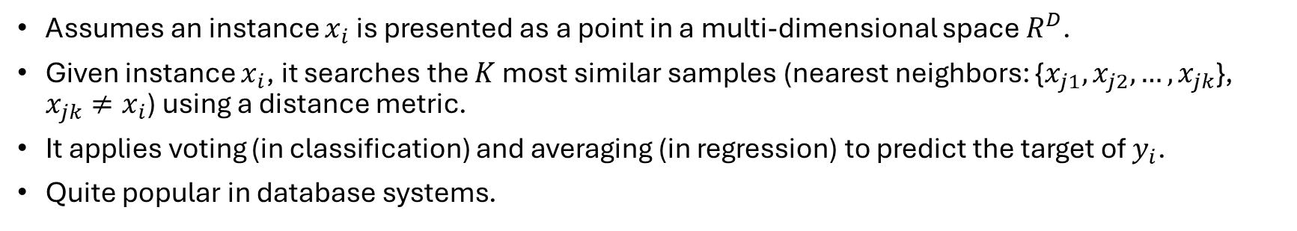
K-Nearest Neighbors (KNN)
Assumes an instance $x_{i}$ is presented as a point in a multi-dimensional space $R^{D}$.
Given instance $x_{i}$, it searches the $K$ most similar samples (nearest neighbors: {$x_{j1},x_{j2},…,x_{jk}$}, $x_{jk}≠x_{i}$) using a distance metric.
It applies voting (in classification) and averaging (in regression) to predict the target of $y_{i}$.
Quite popular in database systems.
Training
Set
KNN in Multi-class

Slide 4
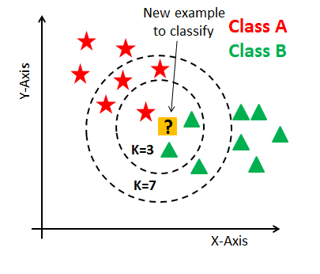
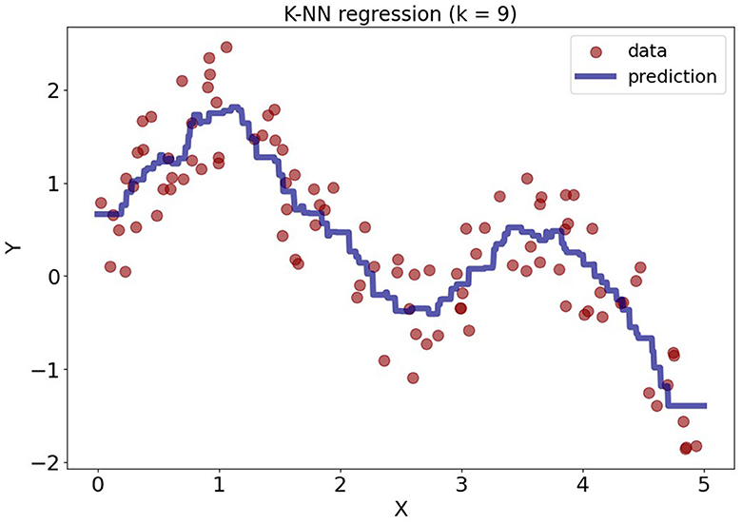
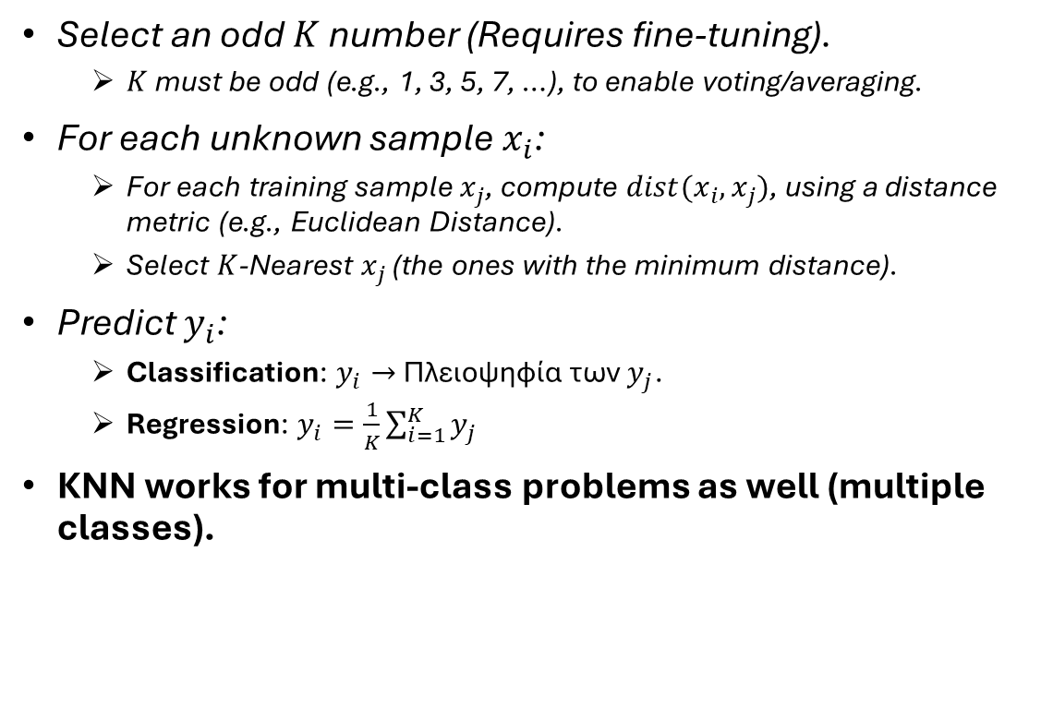
KNN Implementation
Select an odd $K$ number (Requires fine-tuning).
  $K$ must be odd (e.g., 1, 3, 5, 7, …), to enable voting/averaging.
For each unknown sample $x_{i}$:
  For each training sample $x_{j}$, compute $dist(x_{i},x_{j})$, using a distance metric (e.g., Euclidean Distance).
  Select $K$-Nearest $x_{j}$ (the ones with the minimum distance).
Predict $y_{i}$:
  Classification: $y_{i}→$ Πλειοψηφία των $y_{j}$.
  Regression: $y_{i}=\frac{1}{K}\sum_{i=1}^{K}{y_{j}}$
KNN works for multi-class problems as well (multiple classes).

Slide 5
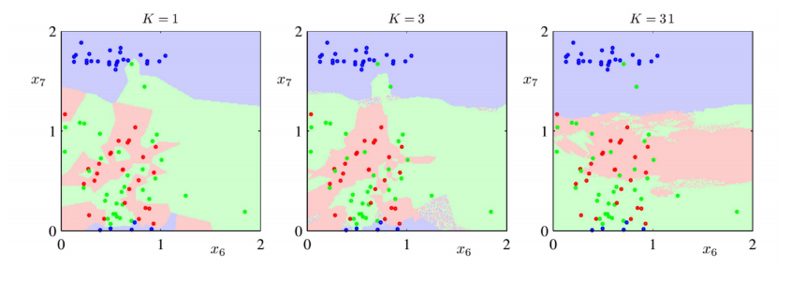
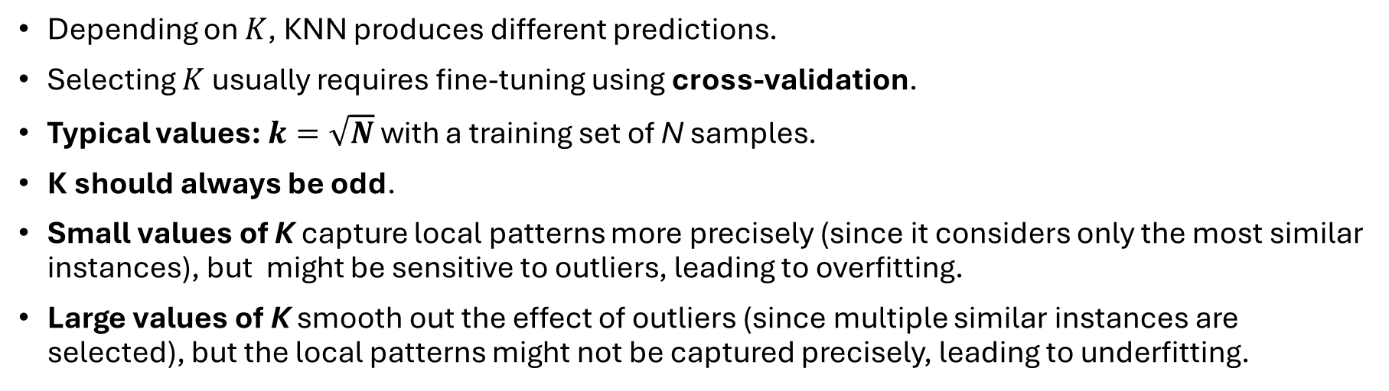
Selecting K Parameter
Depending on $K$, KNN produces different predictions.
Selecting $K$ usually requires fine-tuning using cross-validation.
Typical values: $k=\sqrt{N}$ with a training set of N samples.
K should always be odd.
Small values of K capture local patterns more precisely (since it considers only the most similar instances), but might be sensitive to outliers, leading to overfitting.
Large values of K smooth out the effect of outliers (since multiple similar instances are selected), but the local patterns might not be captured precisely, leading to underfitting.

Slide 6
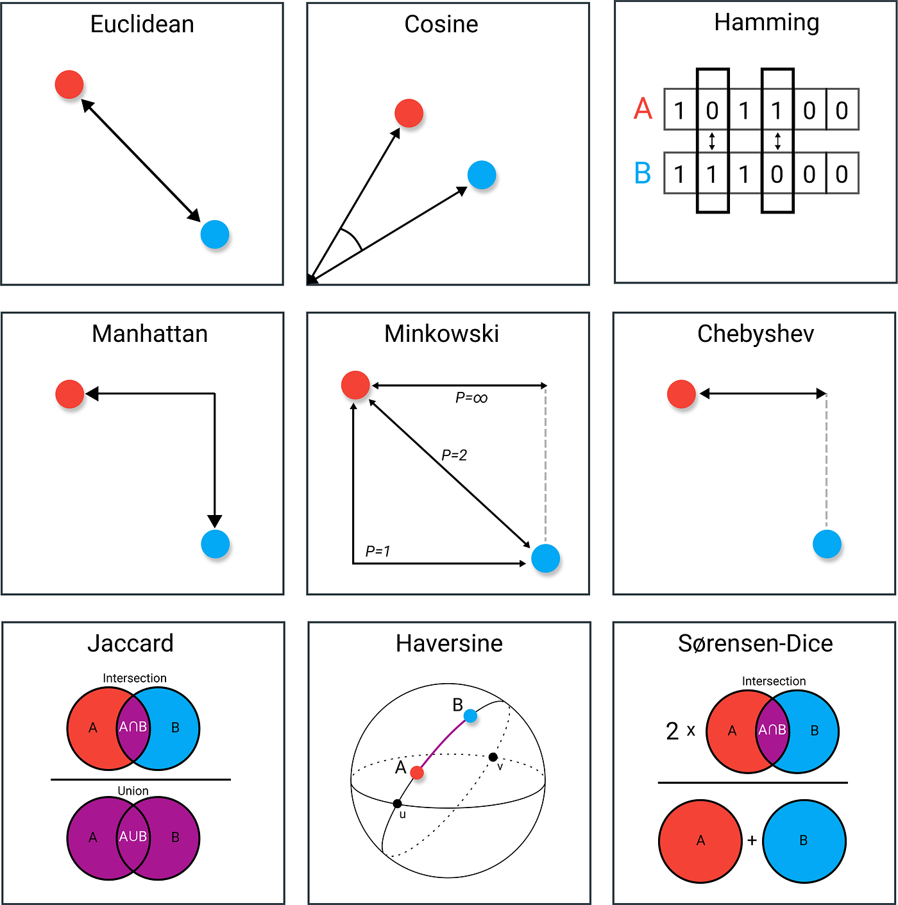
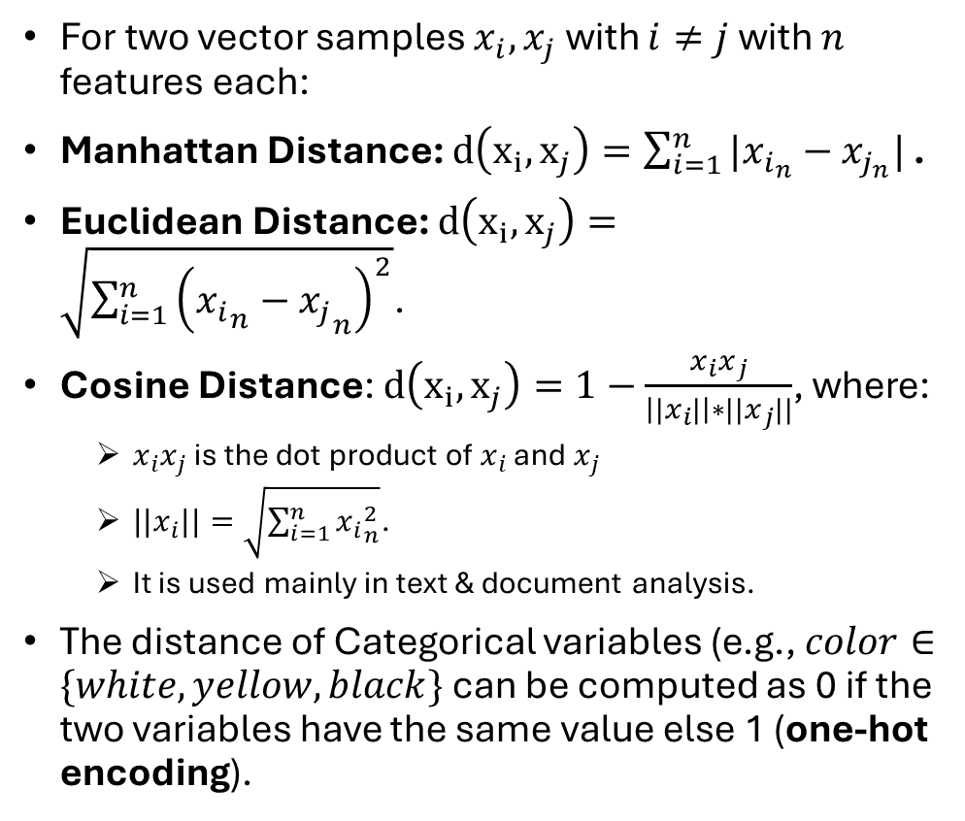
Distance Metrics
For two vector samples $x_{i}, x_{j}$ with $i≠j$ with $n$ features each:
Manhattan Distance: $d\left(x_{i},x_{j}\right)=\sum_{i=1}^{n}{|x_{i_{n}}−x_{j_{n}}| }$.
Euclidean Distance: $d\left(x_{i},x_{j}\right)=\sqrt{\sum_{i=1}^{n}{{\left({x_{i}}_{n}−{x_{j}}_{n}\right)}^{2}}}$.
Cosine Distance: $d\left(x_{i},x_{j}\right)=1−\frac{x_{i}x_{j}}{\left||x_{i}|\right|∗||x_{j}||}$, where:
  $x_{i}x_{j}$ is the dot product of $x_{i}$ and $x_{j}$
  ${||x}_{i}||=\sqrt{\sum_{i=1}^{n}{{x_{i}}_{n}^{2}}}$.
  It is used mainly in text & document analysis.
The distance of Categorical variables (e.g., $color∈\{white, yellow,black\}$ can be computed as 0 if the two variables have the same value else 1 (one-hot encoding).

Slide 7
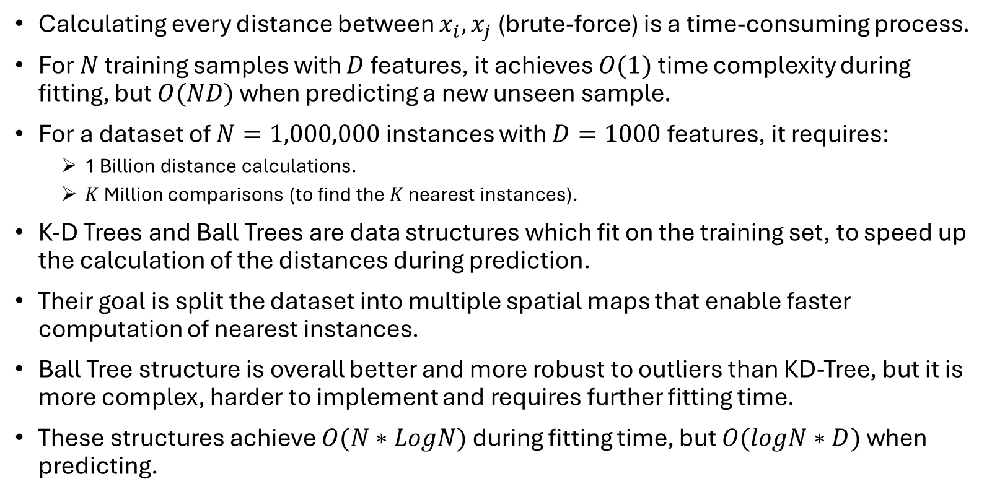
K-D Tree & Ball Tree Structures
Calculating every distance between $x_{i},x_{j}$ (brute-force) is a time-consuming process.
For $N$ training samples with $D$ features, it achieves $O(1)$ time complexity during fitting, but $O(ND)$ when predicting a new unseen sample.
For a dataset of $N=1,000,000$ instances with $D=1000$ features, it requires:
  1 Billion distance calculations.
  $K$ Million comparisons (to find the $K$ nearest instances).
K-D Trees and Ball Trees are data structures which fit on the training set, to speed up the calculation of the distances during prediction.
Their goal is split the dataset into multiple spatial maps that enable faster computation of nearest instances.
Ball Tree structure is overall better and more robust to outliers than KD-Tree, but it is more complex, harder to implement and requires further fitting time.
These structures achieve $O(N∗LogN)$ during fitting time, but $O(logN∗D)$ when predicting.

Slide 8
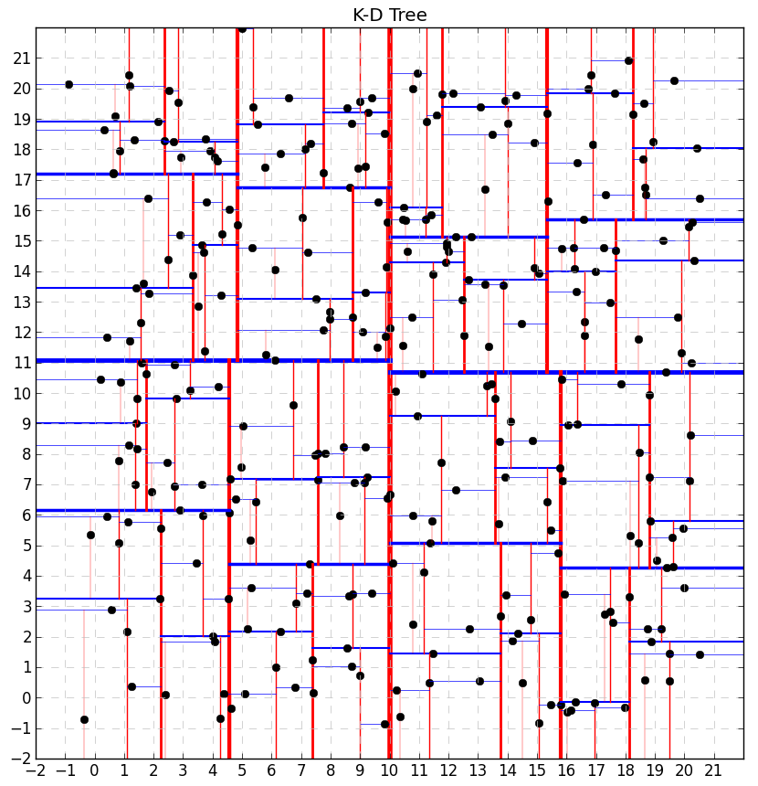
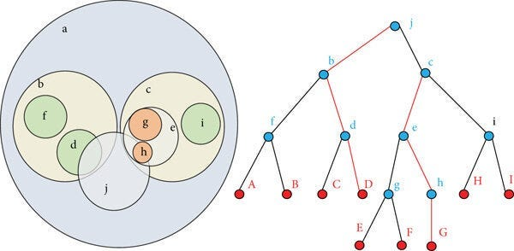
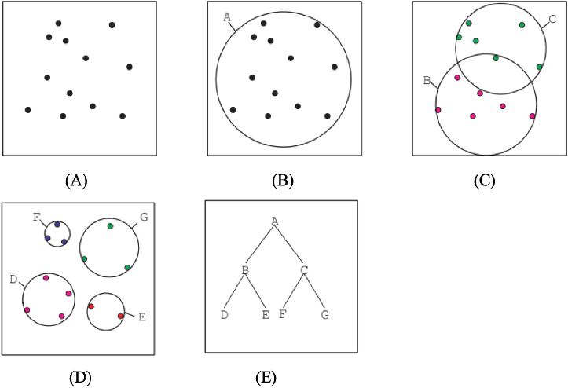
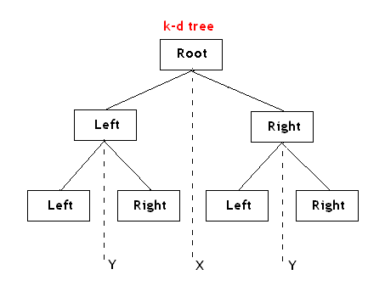
K-D Tree vs Ball Tree Visualization
vs

Slide 9
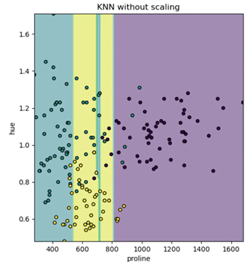
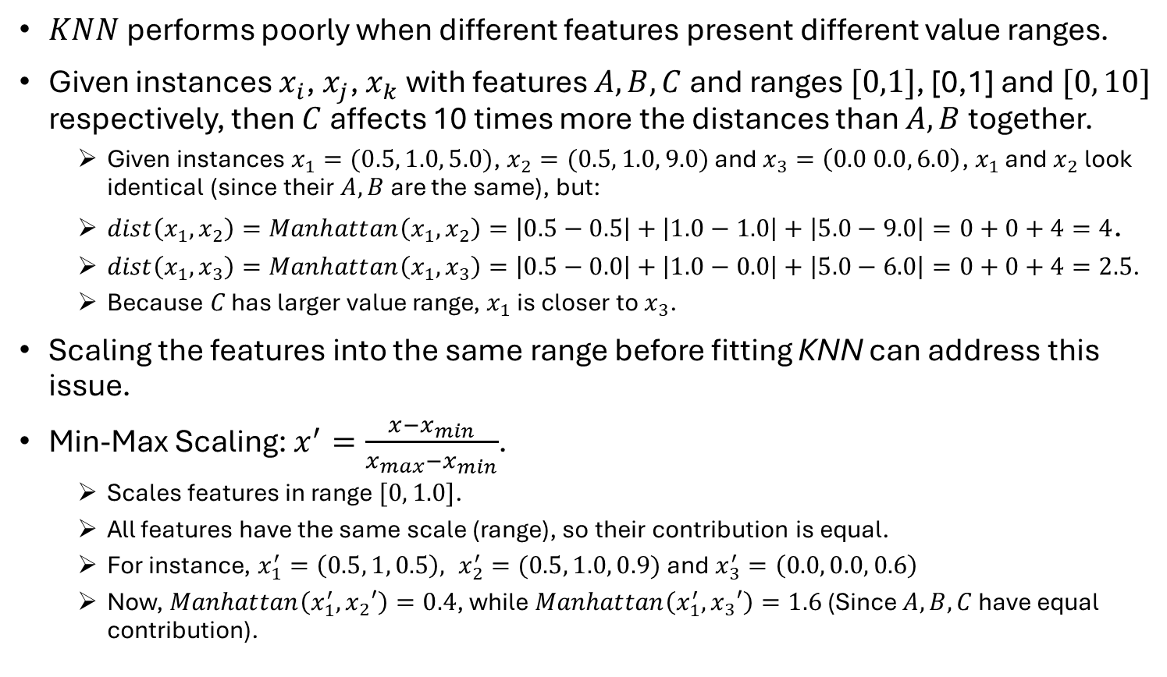
Scaling
$KNN$ performs poorly when different features present different value ranges.
Given instances $x_{i}$, $x_{j}$, $x_{k}$ with features $A,B,C$ and ranges $[0,1]$, [0,1] and $[0, 10]$ respectively, then $C$ affects 10 times more the distances than $A,B$ together.
  Given instances $x_{1}=(0.5, 1.0, 5.0)$, $x_{2}=(0.5, 1.0, 9.0)$ and $x_{3}=\left(0.0 0.0, 6.0\right)$, $x_{1}$ and $x_{2}$ look identical (since their $A,B$ are the same), but:
  $dist\left(x_{1},x_{2}\right)=Manhattan\left(x_{1},x_{2}\right)=\left|0.5−0.5\right|+\left|1.0−1.0\right|+\left|5.0−9.0\right|=0+0+4=4$.
  $dist\left(x_{1},x_{3}\right)=Manhattan\left(x_{1},x_{3}\right)=\left|0.5−0.0\right|+\left|1.0−0.0\right|+\left|5.0−6.0\right|=0+0+4=2.5$.
  Because $C$ has larger value range, $x_{1}$ is closer to $x_{3}$.
Scaling the features into the same range before fitting KNN can address this issue.
Min-Max Scaling: $x^{′}=\frac{x−x_{min}}{x_{max}−x_{min}}$.
  Scales features in range $[0, 1.0]$.
  All features have the same scale (range), so their contribution is equal.
  For instance, $x_{1}^{′}=\left(0.5, 1, 0.5\right), x_{2}^{′}=(0.5, 1.0, 0.9)$ and $x_{3}^{′}=\left(0.0, 0.0, 0.6\right)$
  Now, $Manhattan\left(x_{1}^{′},x_{2}′\right)=0.4$, while $Manhattan\left(x_{1}^{′},x_{3}′\right)=1.6$ (Since $A,B,C$ have equal contribution).

Slide 10
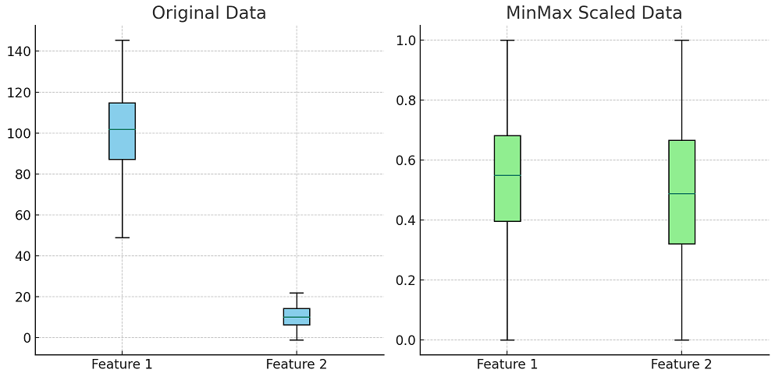
Scaling Visualization

Slide 11
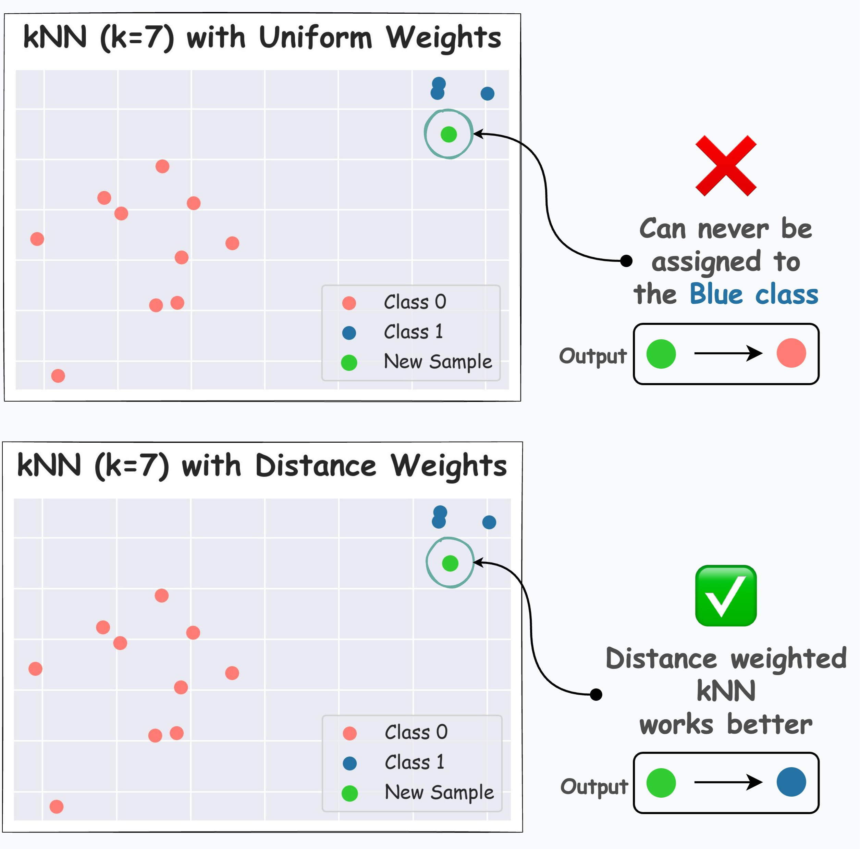
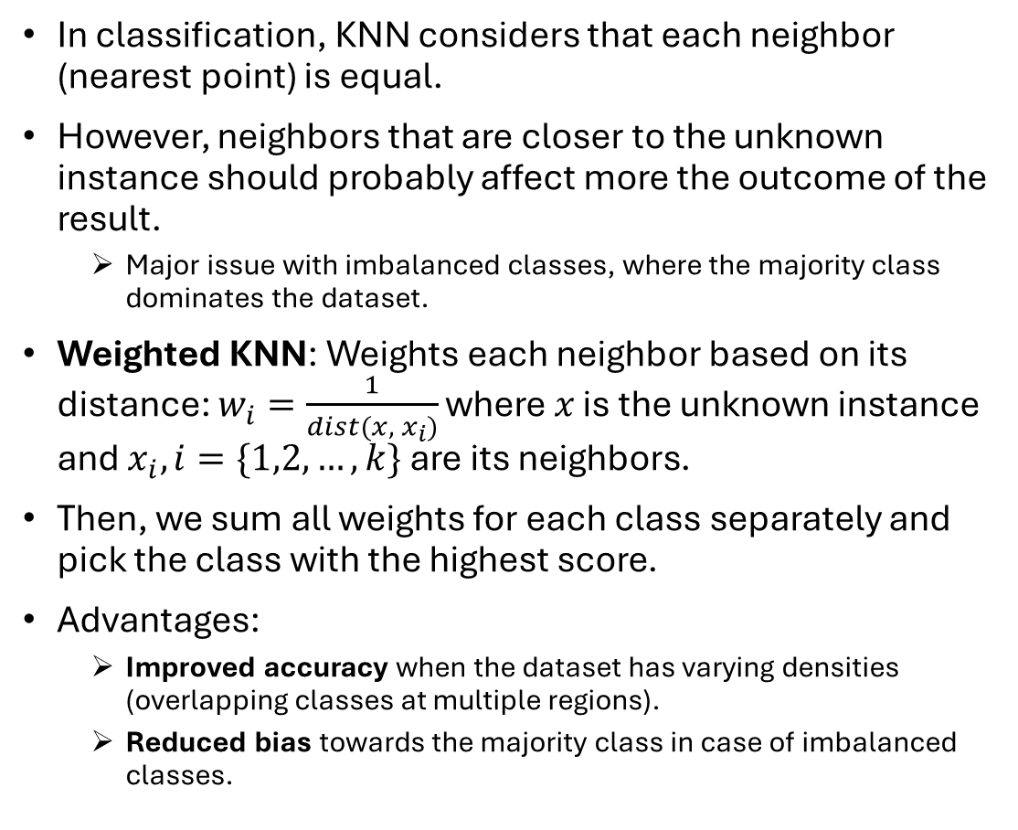
Weighted KNN
In classification, KNN considers that each neighbor (nearest point) is equal.
However, neighbors that are closer to the unknown instance should probably affect more the outcome of the result.
  Major issue with imbalanced classes, where the majority class dominates the dataset.
Weighted KNN: Weights each neighbor based on its distance: $w_{i}=\frac{1}{dist(x, { x}_{i})}$ where $x$ is the unknown instance and $x_{i}, i=\{1,2,…,k\}$ are its neighbors.
Then, we sum all weights for each class separately and pick the class with the highest score.
Advantages:
  Improved accuracy when the dataset has varying densities (overlapping classes at multiple regions).
  Reduced bias towards the majority class in case of imbalanced classes.

Slide 12
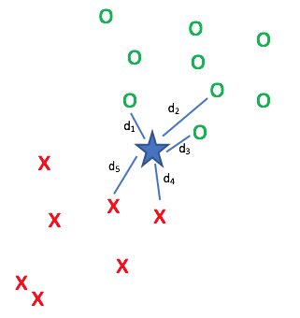

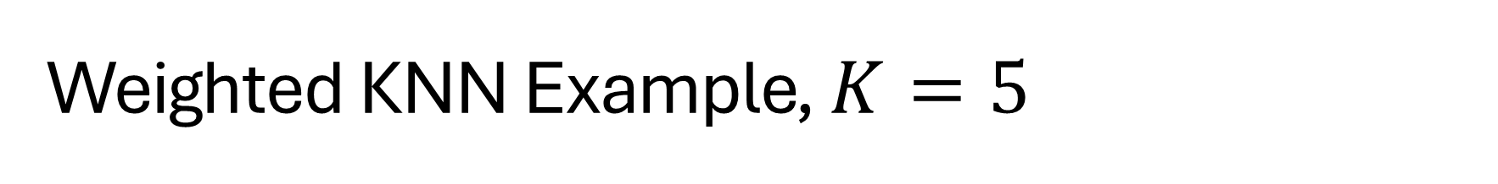
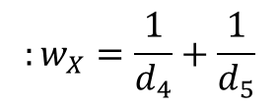

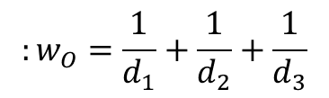
Weighted KNN Example, $K=5$
$$d→Euclidean$$
$$:w_{O}=\frac{1}{d_{1}}+\frac{1}{d_{2}}+\frac{1}{d_{3}}$$
$$:w_{X}=\frac{1}{d_{4}}+\frac{1}{d_{5}}$$
$$y=max⁡\{w_{O},w_{X}\}$$

Slide 13
Machine Learning
K-Nearest Neighbors Notes

